Slide 1

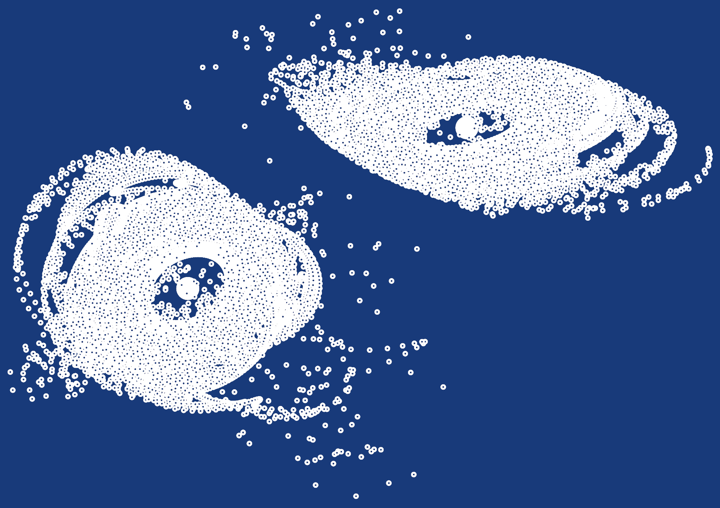
Simulating Interacting Galaxies The results of a high school internship project
Michael Thiel
Manuel Brea-Carreras

Slide 2
Acknowledgements
Markus Pössel
Haus der Astronomie
MPIA

Slide 3
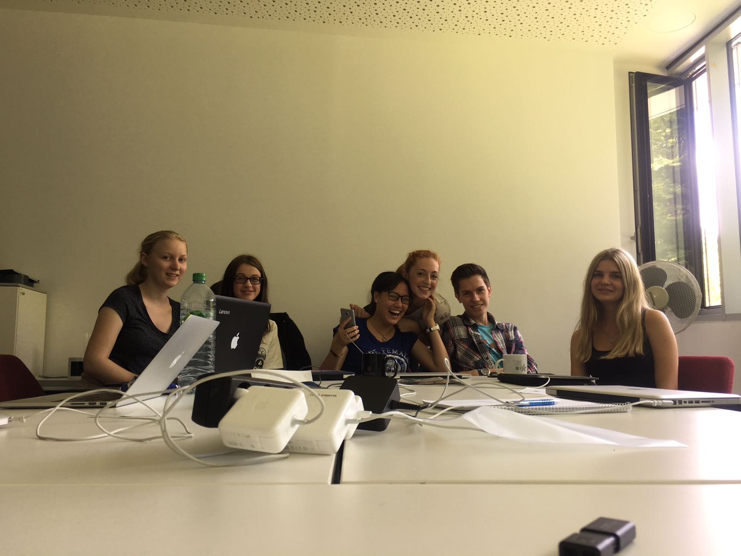
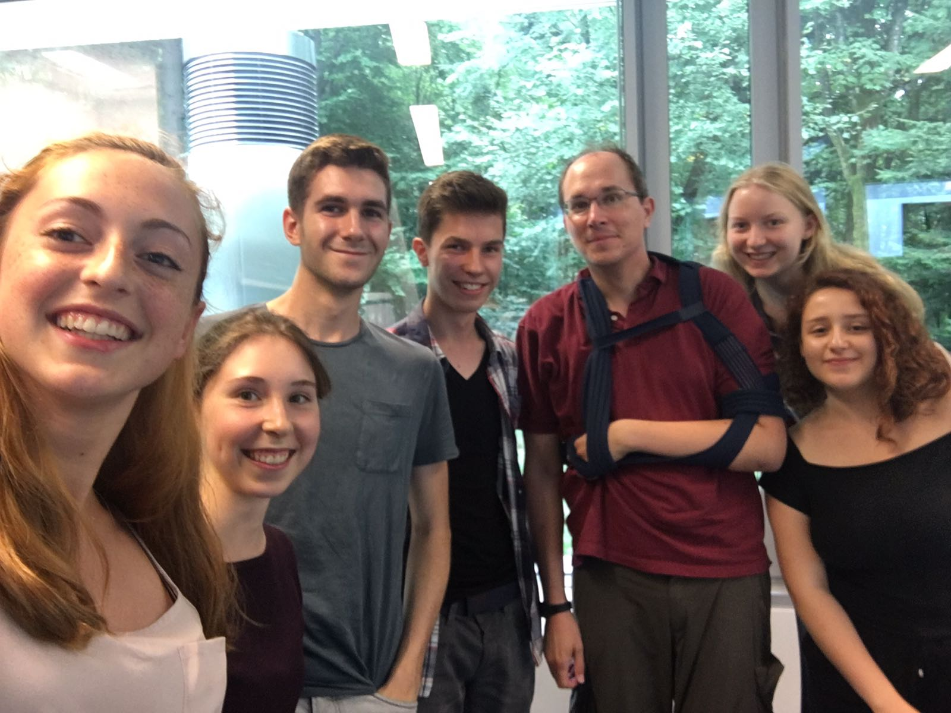
International Summer Internship at HdA 2017

Slide 4
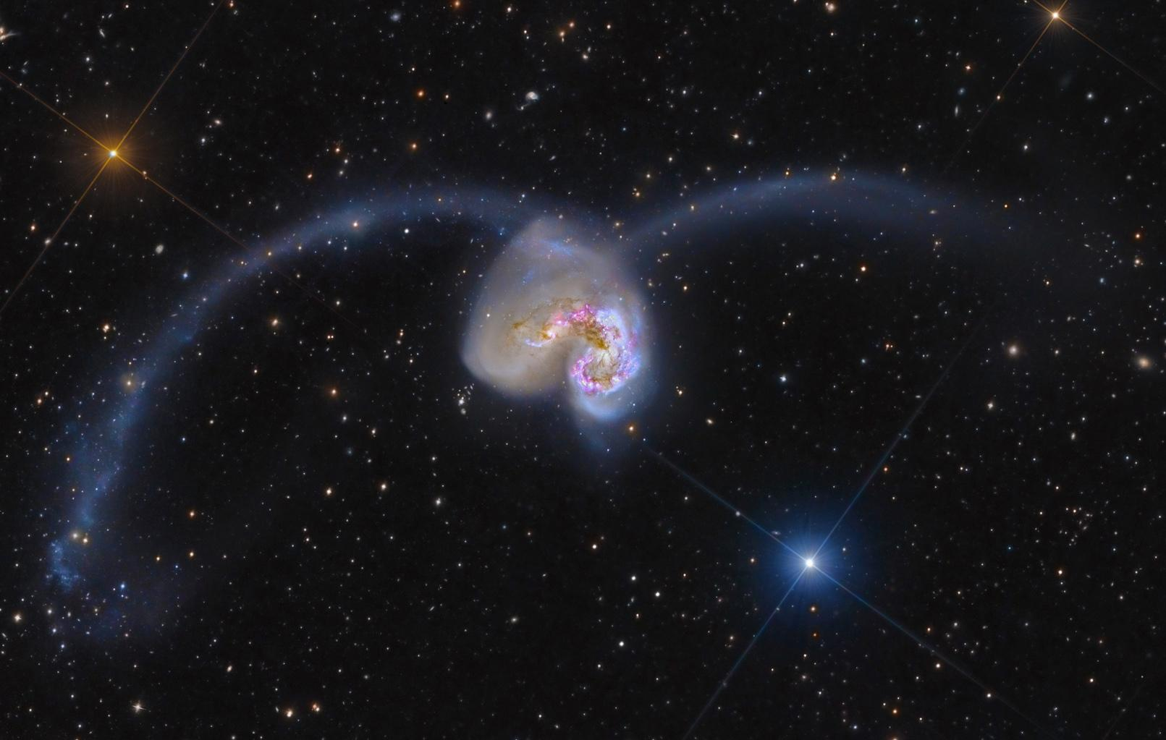
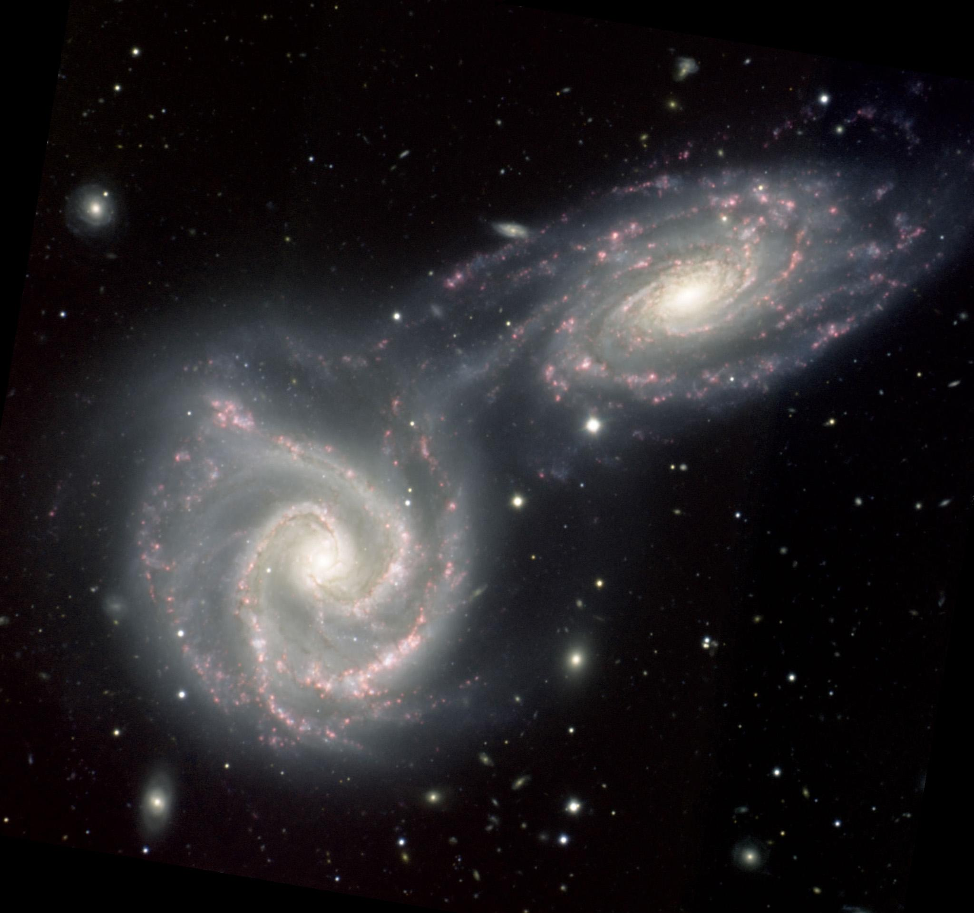
Galaxy Evolution - applied to our project

Slide 5
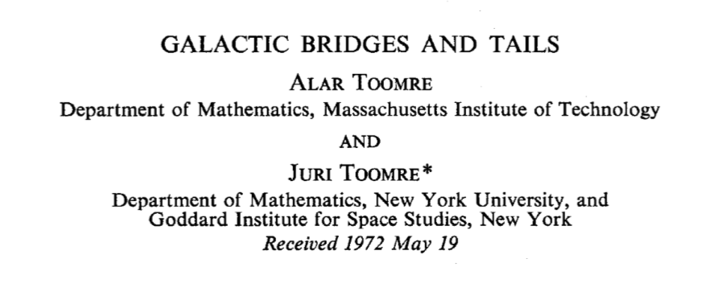
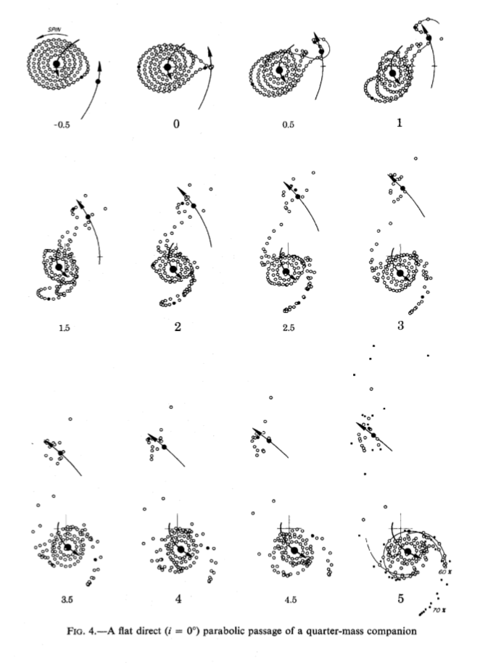
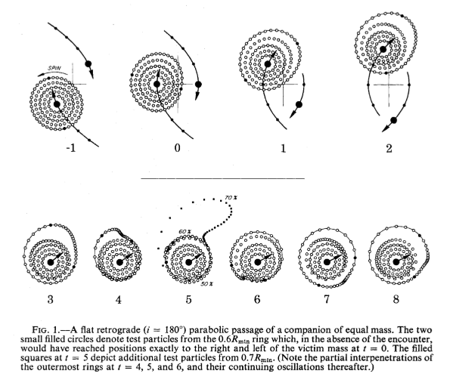
Main reference and inspiration

Slide 6
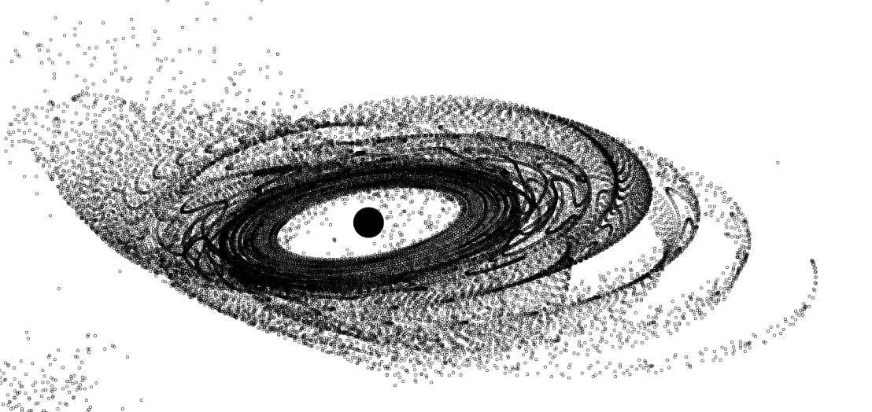





Structure of the Simulation
Matplotlib
output
Update function

Slide 7
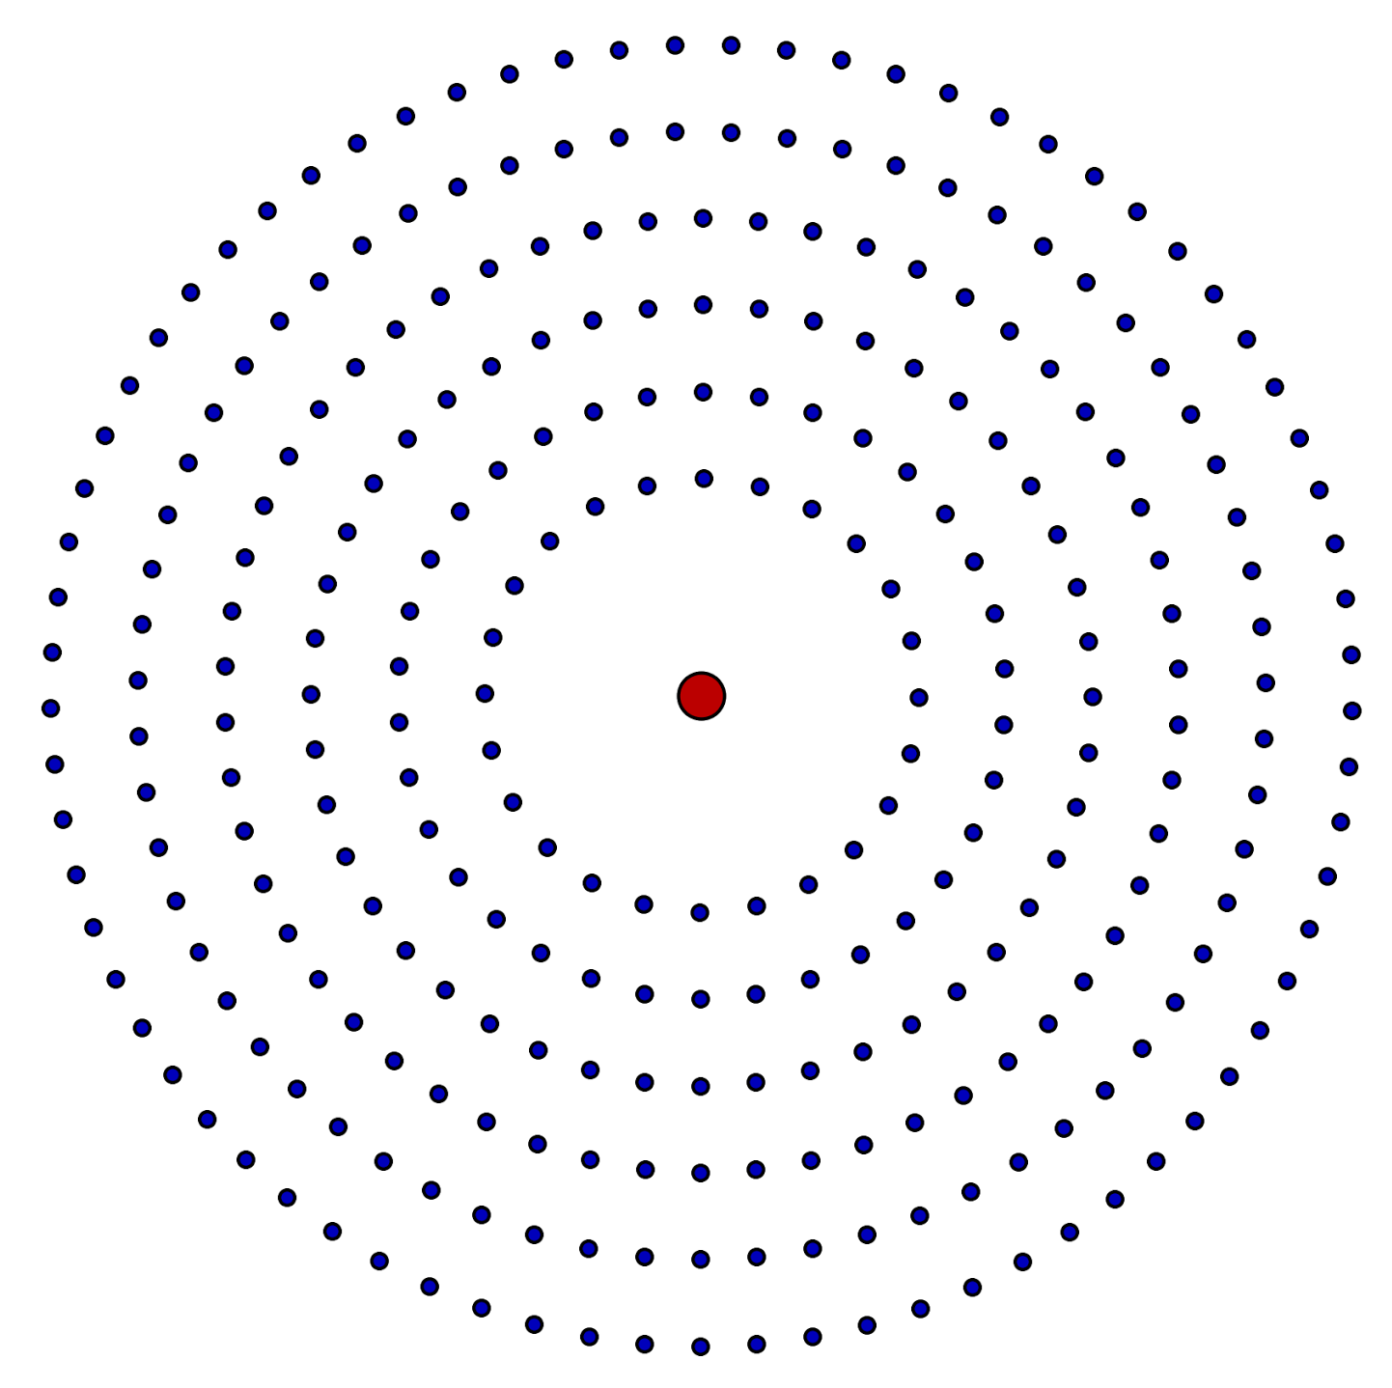
Structure of the Simulation
Galaxy
Center of mass
Orbiting particles
Position
x, y, z
Position
x, y, z
Velocity
x, y, z
Velocity
x, y, z
Mass
m
Mass
m

Slide 8

Structure of the Simulation
Update function
Analytical solution
Two bodies
Numerical solution
Any number of bodies

Slide 9







Structure of the Simulation
Euler Integration
Time update
Velocity Verlet
Half velocity update
Velocity update
Position update
Position update
Velocity update
For

Slide 10
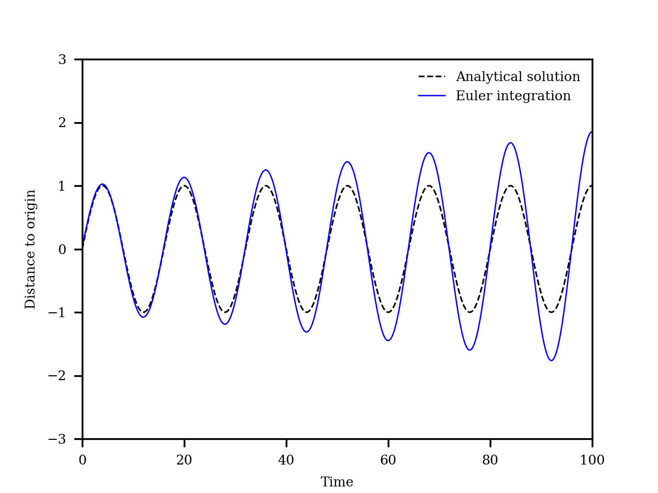
Structure of the Simulation

Slide 11
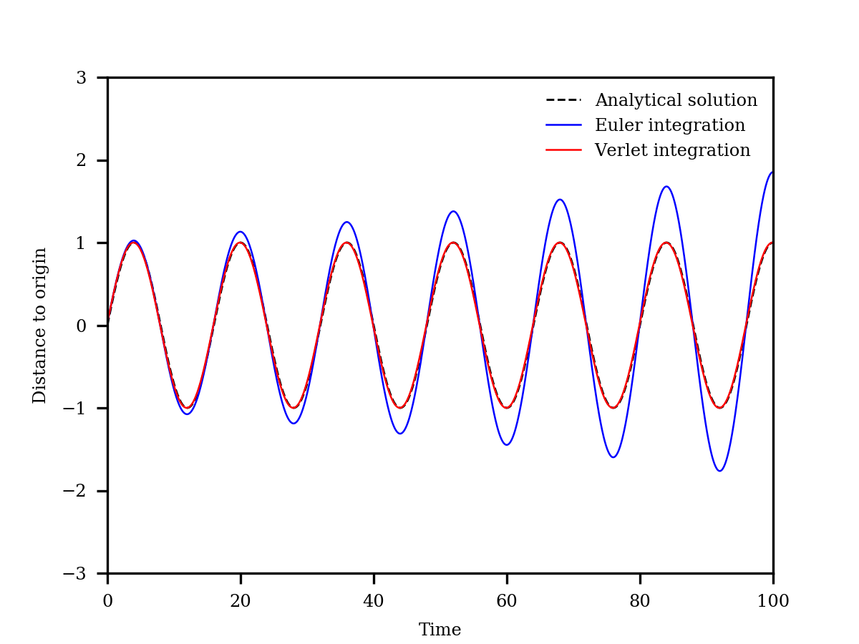
Structure of the Simulation

Slide 12
Structure of the Simulation
Why use numpy’s linear algebra libraries?
Simulation times on “light” example:
More than a 200-fold improvement
Vectorized algorithm | 13.26 s
Iterative algorithm | 2874.42 s

Slide 14


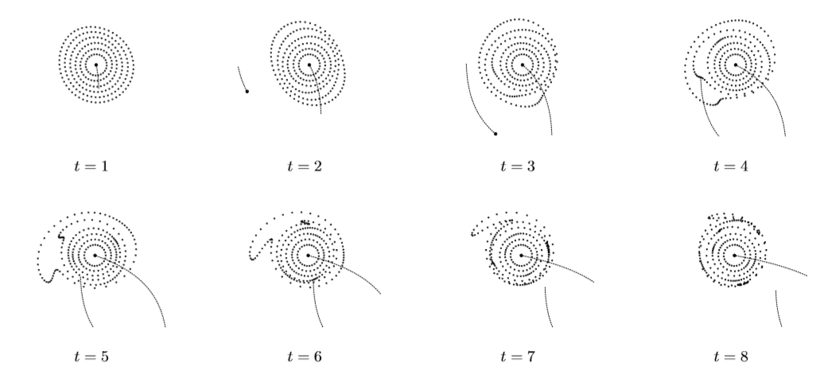
Results - Two Elementary Examples
kpc

Slide 15


Slide 16
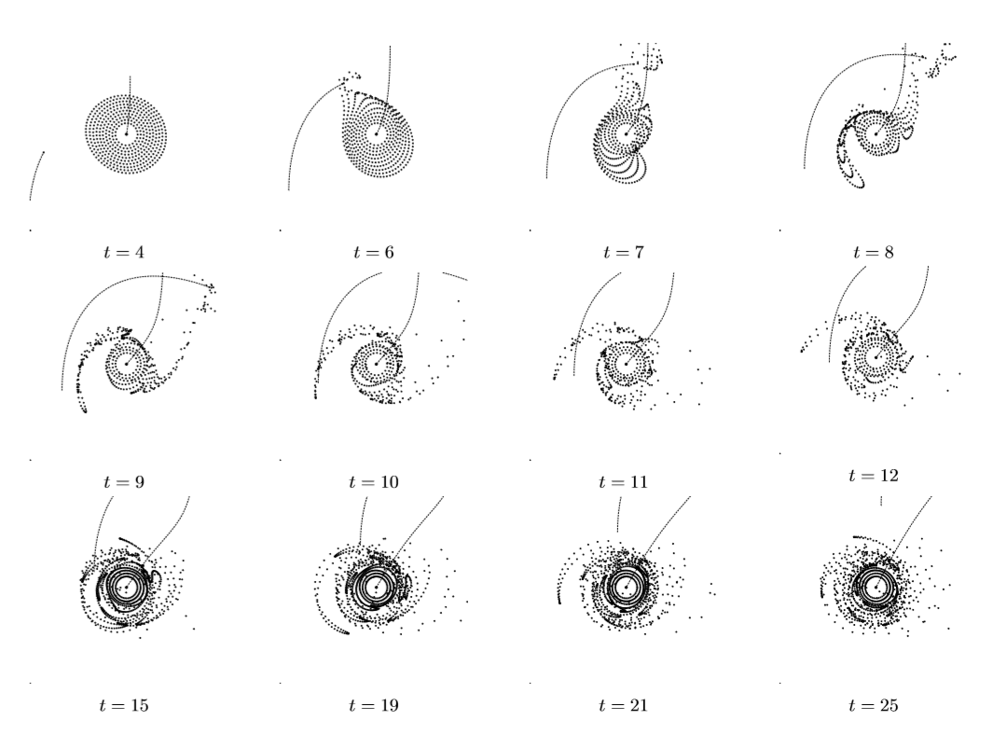


Results - Two Elementary Examples
kpc

Slide 18
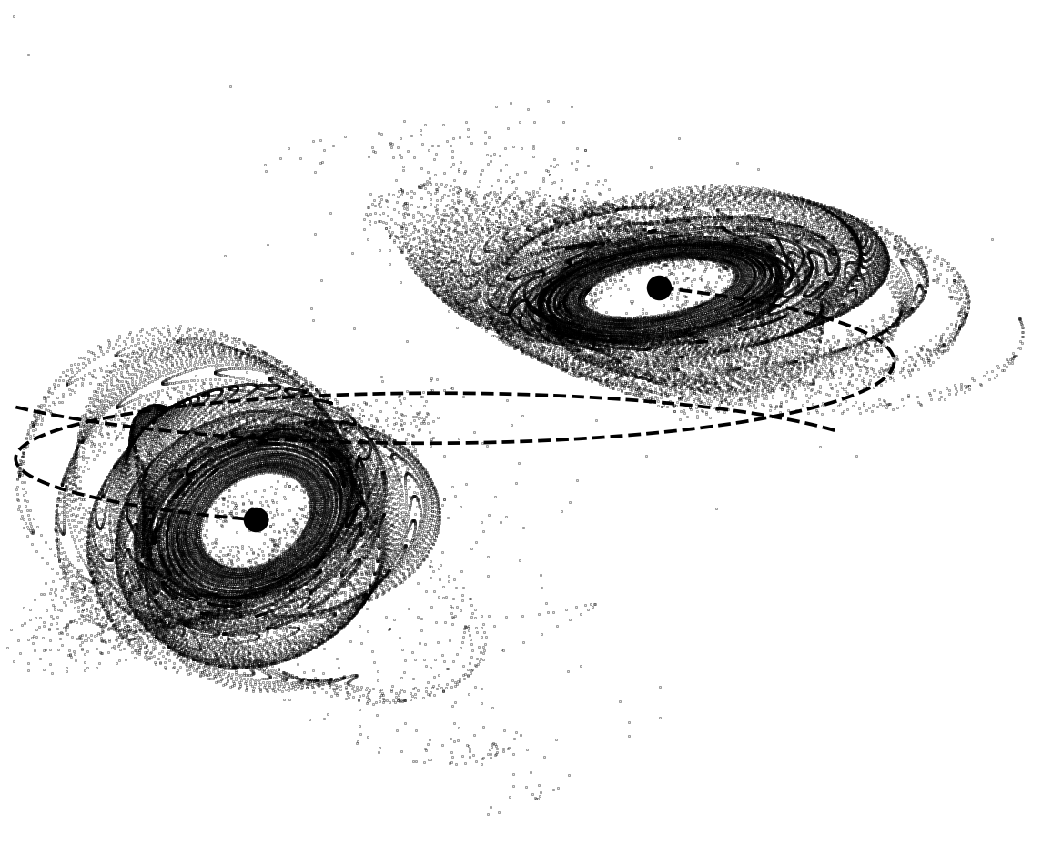


Results - Simulation of NGC 5426/7 pair
kpc

Slide 19
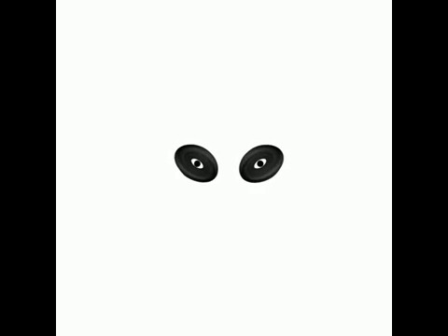

Slide 20
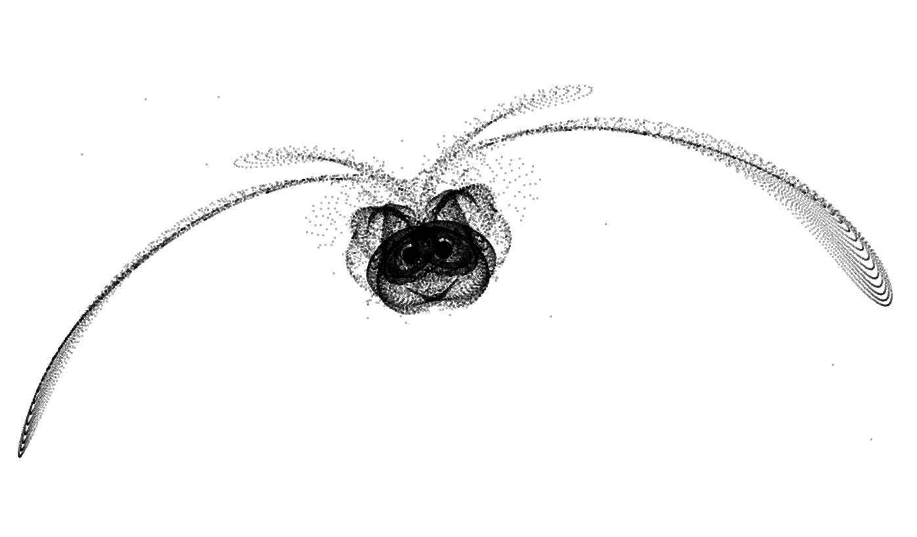


Results - Simulation of NGC 4038/9 pair
kpc

Slide 21
Our personal experience
Obstacles we faced
What kept us motivated?
What we learned from the project

Slide 22
Application to Education
Importance of the project
Simplifications
Pre-requirements for students

Slide 23
Bibliography
Toomre, A., and Toomre, J. 1972, in Galactic Bridges and Tails
https://apod.nasa.gov/apod/ap150212.html
https://apod.nasa.gov/apod/ap130825.html

